Slide 1


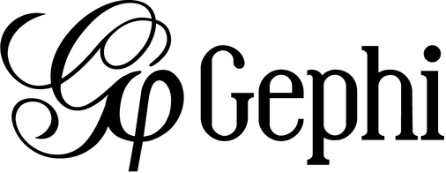
Social Network Analysis of Music Streaming Networks: Deezer Case
Group members: Marta Manevska 20220056 Antonina Filatova 20221104 Raymond Pau 20220046 Abrar Hossain Asif 20220223 Eduardo Pedro Caperta 20220234

Slide 2
content
1. Overview
2. Theoretical Background
3. Modularity and Community
4. Degree Centrality
5. HUBS
6. Betweenness Centrality
7. Eigenvector Centrality
8. Eigenvector Centrality vs Betweenness Centrality
9. Top 100 Nodes
10. Recommendations

Slide 3
OVERVIEW
By using Gephi’s modularity class feature, top 3 communities in subscription model were identified.
No gender-related communities were detected.
Based on centralities and hub measures there was found a list of users with efficient way transmitting information in the network, these top 100 users are recommended to target.

Slide 4
THEORETICAL BACKGROUND
Modularity - the degree to which components of a system can be separated and recombined.
Degree Centrality - important score based simply on the number of links held by each node.
Betweenness Centrality - the number of times a node lies on the shortest path between other nodes.
Eigen Centrality - a node’s influence based on the number of links it has to other nodes in the network. Eigen Centrality then goes a step further by also taking into account how well connected a node is, and how many links their connections have, and so on through the network.

Slide 5
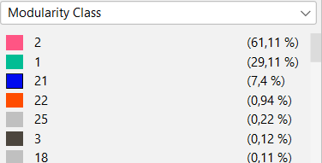
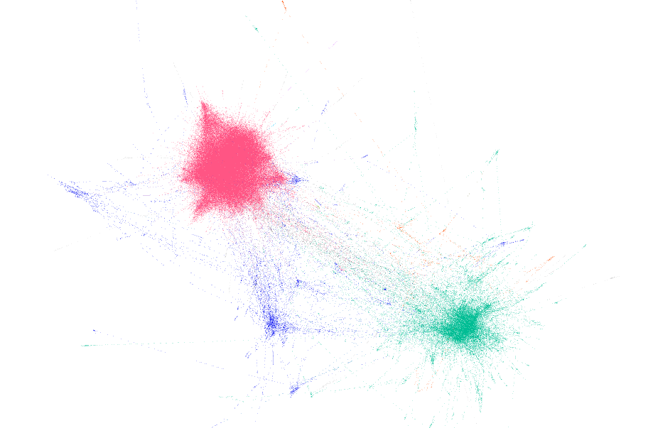
Modularity and community
By using modularity resolution 6.0 which 31 different communities were found.
Three big communities are found
Blue community has 7% of users and they are less connected to each other however they are connected to previous 2 groups

Slide 6
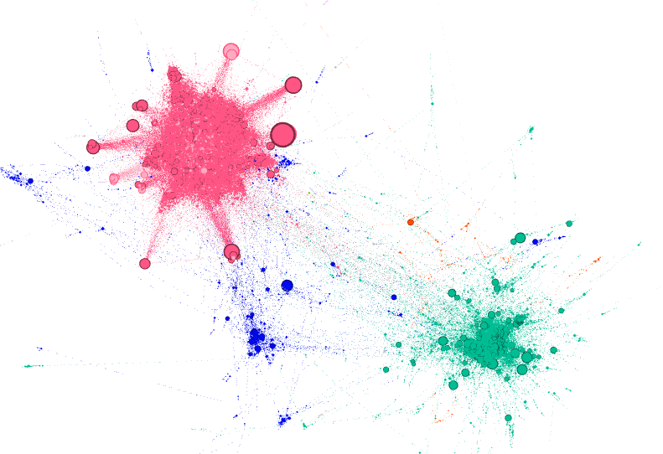
Degree centrality
In every community, there are very connected individuals, popular individuals, individuals who are likely to hold most information or individuals who can quickly connect with the wider network using degree centrality

Slide 7
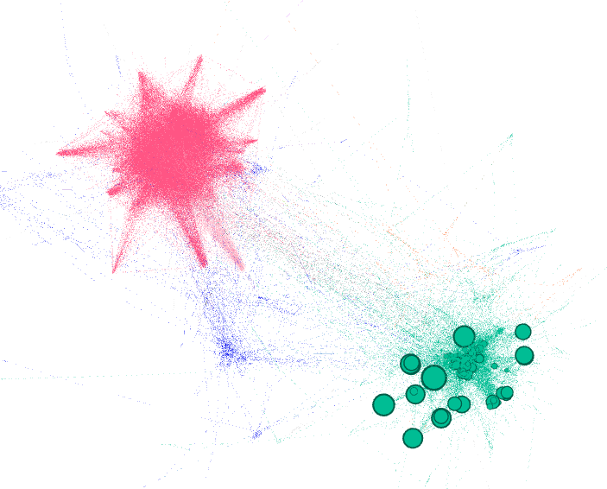
hubs
Most of the HUBS are found in the second community (green).
Network is undirected so we cannot detect “one way influencers”
We can investigate, which nodes are the most connected measuring degree, centrality and finding hubs.
Interestingly, majority of hubs belong to green community, while all communities have nodes with high degree, especially red one.
HITS on undirected graphs makes little sense

Slide 8
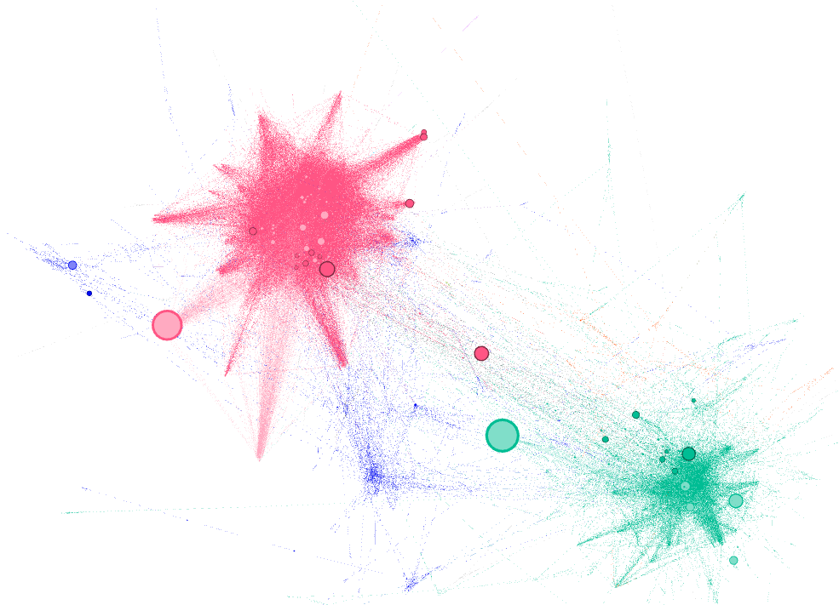
betweenness centrality
There are few nodes with high betweenness centrality in all the top 3 groups
The green and the red ones are the most significant

Slide 9
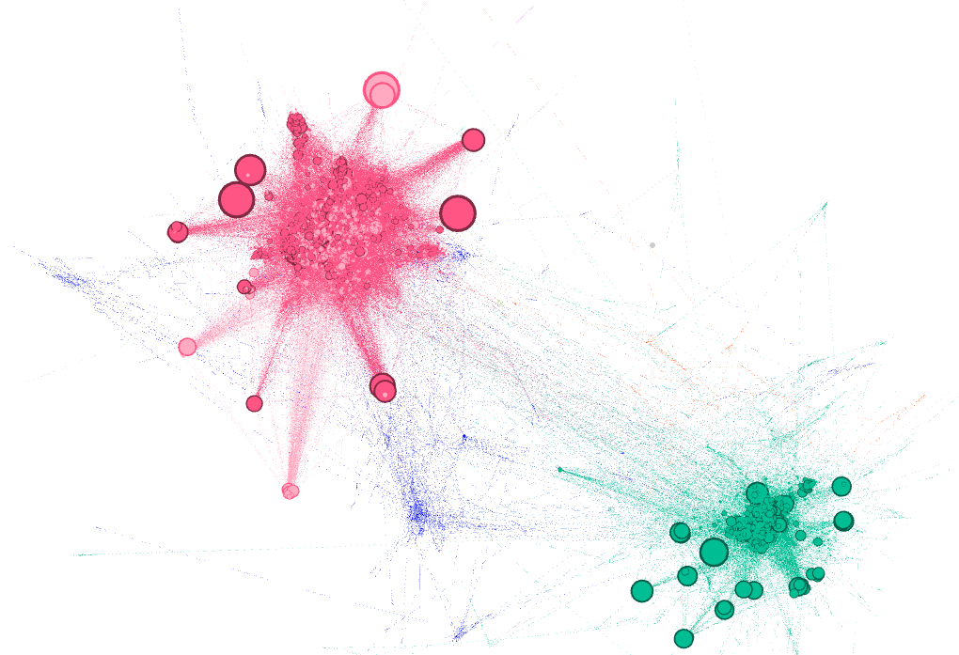
Eigenvector centrality
There are nodes with high Eigenvector centrality and high degree at the same time in the green and the red communities

Slide 10
EIGVENTOR CENRALITY VS BETWEENNESS CENTRALITY
A high betweenness count could indicate someone holds authority over disparate clusters in a network, or just that they are on the periphery of both clusters.
By calculating the extended connections of a node, Eigen Centrality can identify nodes with influence over the whole network, not just those directly connected to it. This is a good ‘all-round’ SNA score, handy for understanding human social networks.

Slide 11
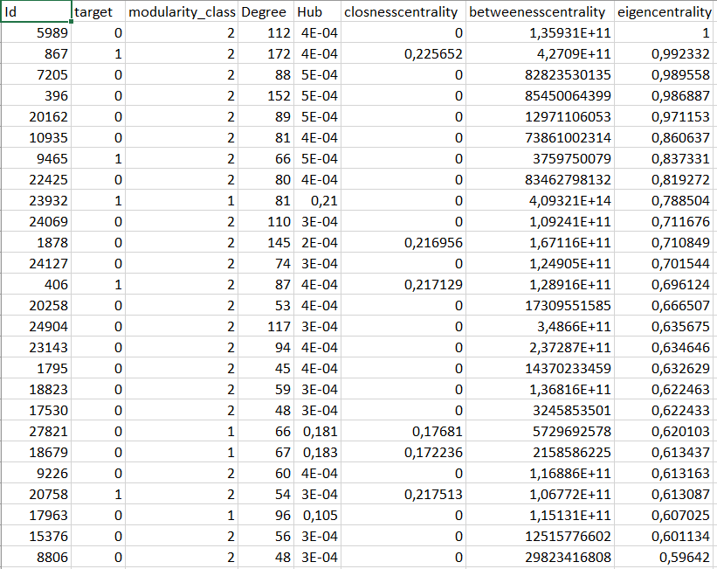
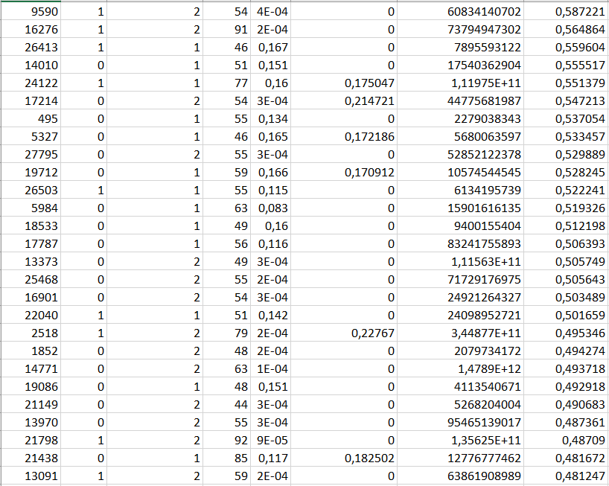
Top 100 nodes
This is a list of nodes with high centrality measures filtered by eigenvector centrality.
Nodes belong to 3 top communities and the structure of the list is proportional to the network
These communities are very bonded within themselves and stand far away from each other on the graph

Slide 12
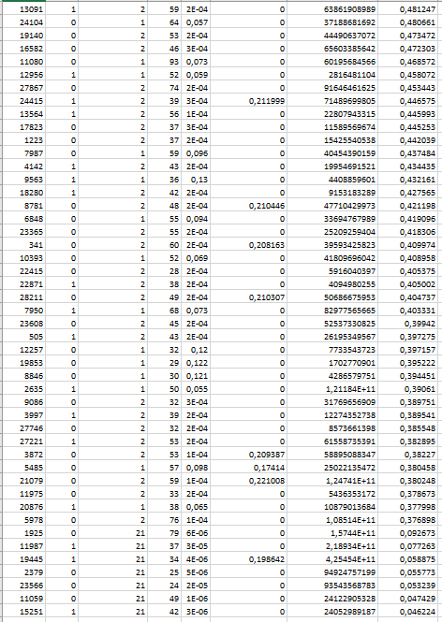
From Top 3 communities we have selected nodes which are: 60% From Modularity 2 30% From Modularity 1 10% From Modularity 21

Slide 13
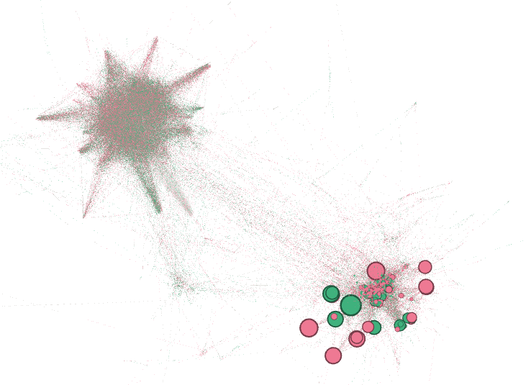
Gender communities
There is no clear separation by gender within groups, gender structure of communities are similar with the ones of the network.

Slide 14
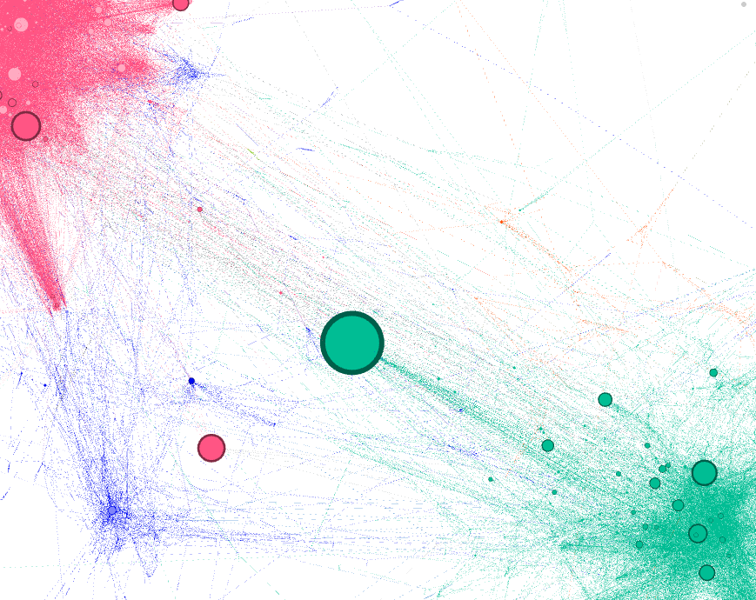
Recommendations
The 100 nodes on the table – are the most connected ones, hence they reach big number of users – we recommend to target them
It’s recommended to target influencers from top 3 communities to make sure the whole network is covered
Gender-based marketing might not bring value for the company as gender balance within communities is not significantly different from the network
It is recommended to as well pay attention to users with high degree from the blue community. They are a “bridge” between red and green groups which are at the moment poorly communicating and the have a potential to increase connectedness of the overall network
As an extra recommendation for Deezer strategy is to pay attention to users with high betweenness centrality as they are connecting top communities between each other.

Slide 15
THANK YOU!

